Slide 1
Practical Data Visualization Best Practices
dataMinds Saturday
Koen Verbeeck
2021-03-13

Slide 2









contact information
(he/him/his)
koen dot verbeeck at ae dot be
@Ko_Ver
LinkedIn
https://sqlkover.com
Notes:
Introduce yourself but keep it short. Mention your years of experience and how they can reach you.

Slide 3

agenda
Notes:
The agenda for today?
First we’ll talk about why data visualization is important and why it’s such a hot topic right now
Next we’ll go over some “bad examples”.
Then we’ll cover some best practices: know your audience, which chart types to choose, pie charts et cetera
We’ll finish with the Gestalt principles and table design; and if there’s time left: how to lie with charts

Slide 4
some questions
Why do you think data visualization is such a hot topic right now?
Is it important for business intelligence?
How much time do you spent on designing a report/dashboard?
Do you think data viz is dependent on the tool used?

Slide 5
Why?
Notes:
why is a session about data viz necessary?

Slide 6
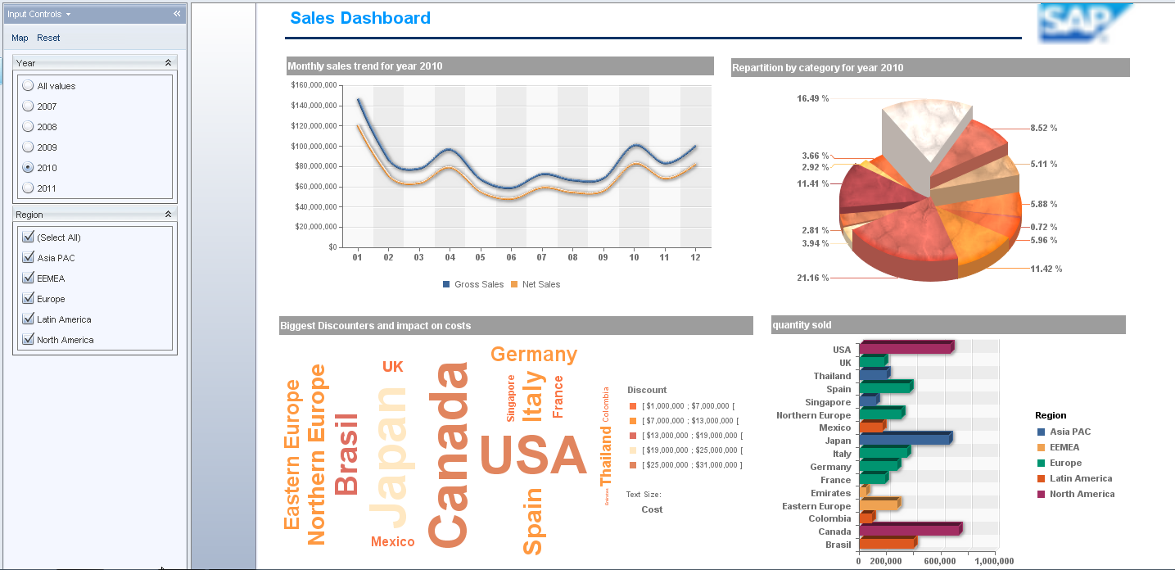
why?
Notes:
The vendor logo is blurred to protect the innocent.

Slide 7
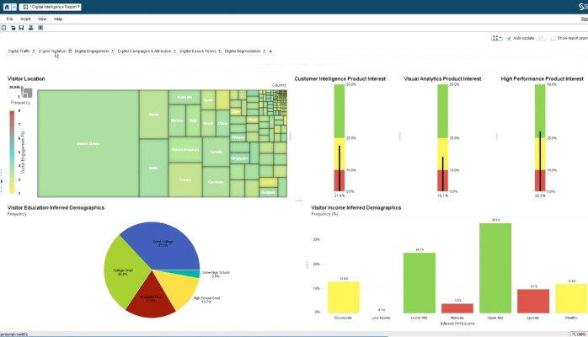
why?
Notes:
SAS, found on LinkedIn heading an article called “Why I love Data Visualization, and you should too!”.
Seems like an abusive relationship.

Slide 8
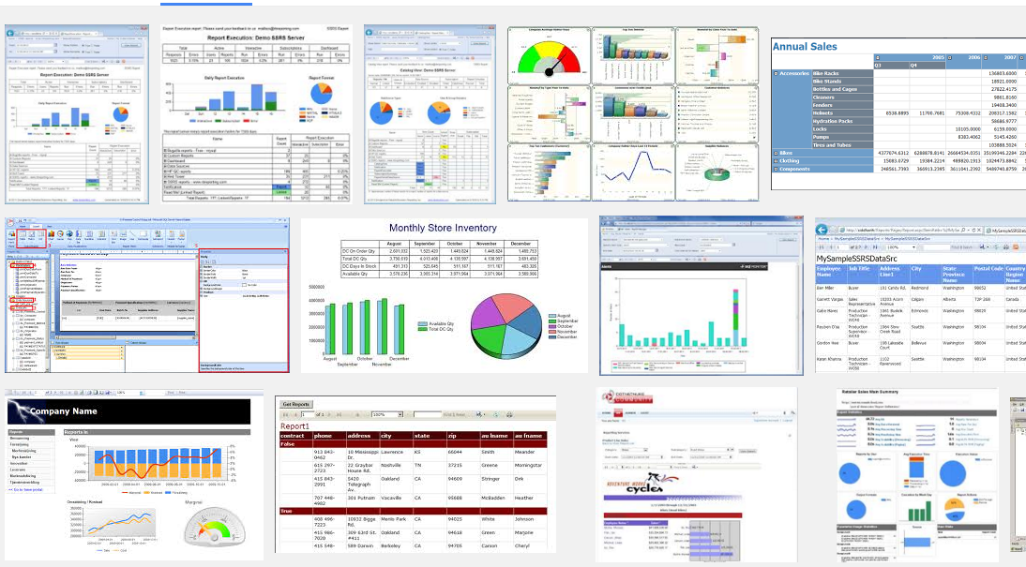
why?
Notes:
But SSRS is not perfect either. Some results after googling “SSRS reports”.

Slide 9
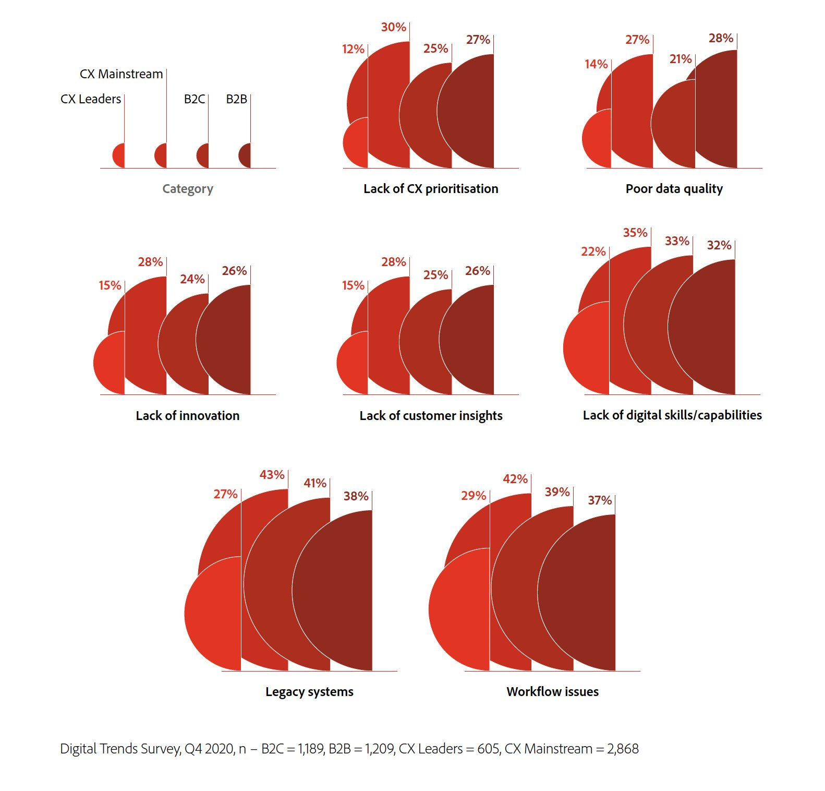
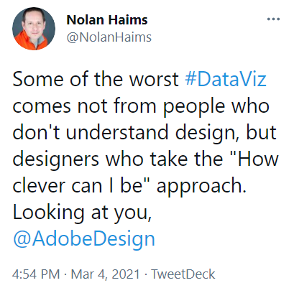
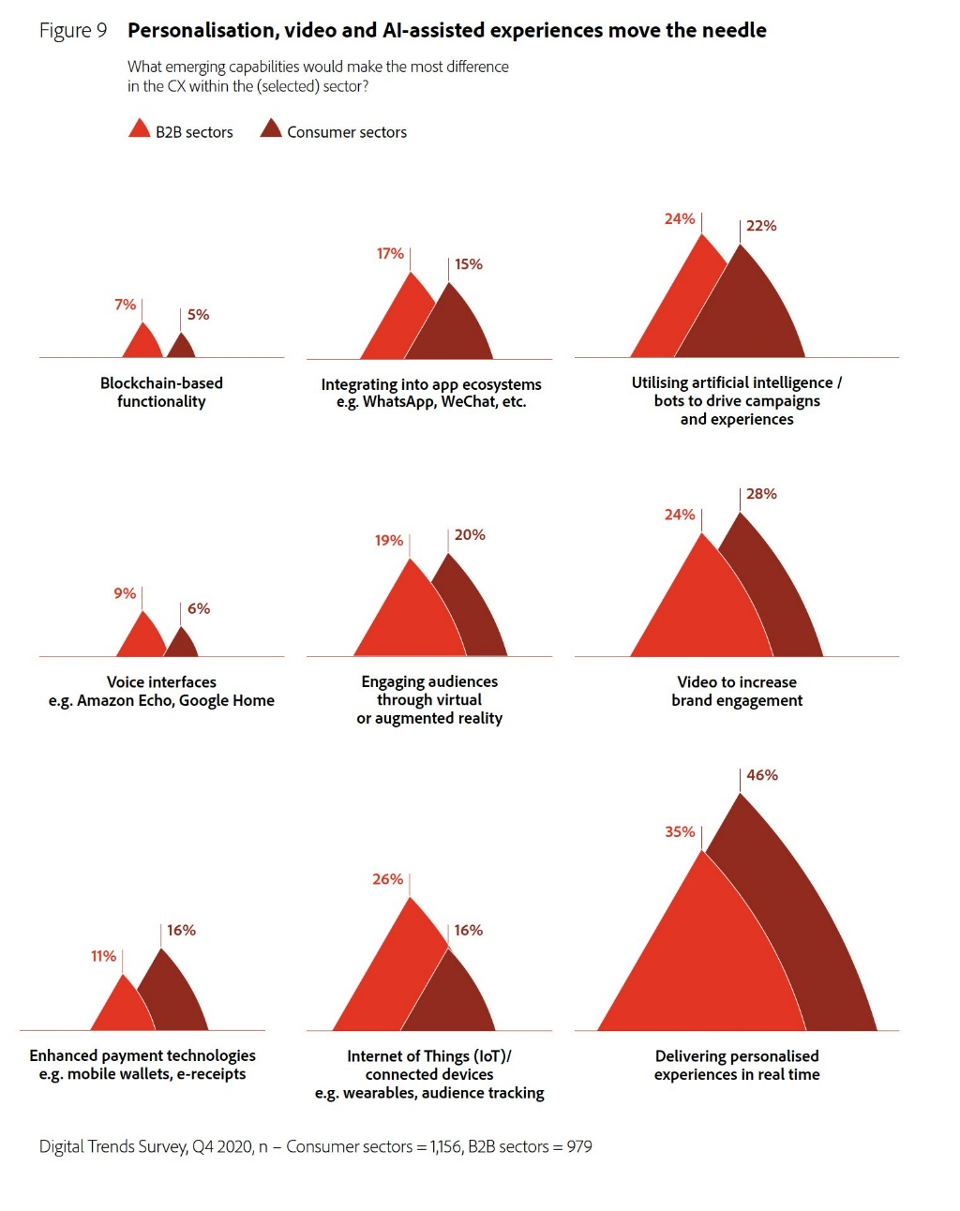
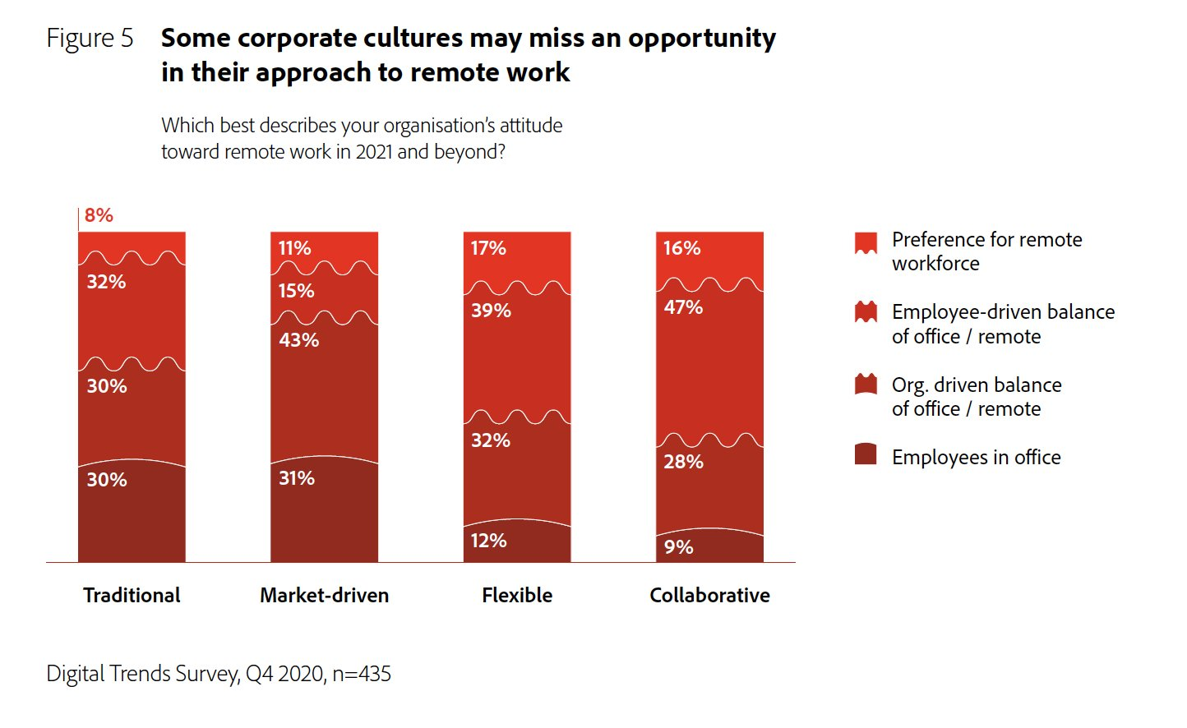
why?

Slide 10


Slide 11
BEST PRACTICES
Notes:
Let’s take a look at some best practices. Remember, best practices are not set in stone.

Slide 12
#1 Know your audience
Notes:
Audience is important. The CEO probably wants a high-level dashboard and not an Excel file full with numbers. The financial analyst vice versa. Also the level of interactivity is important.

Slide 13
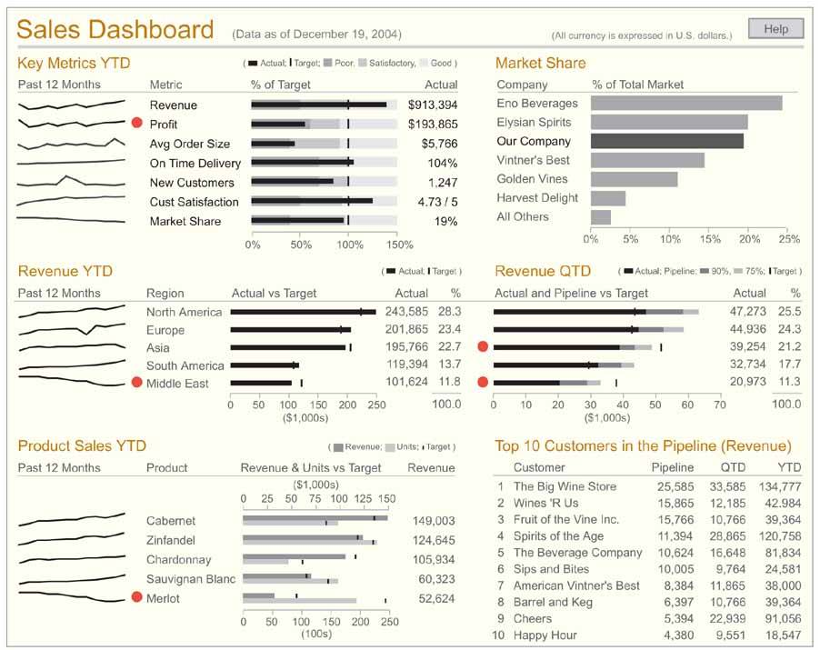
know your audience
Notes:
Strategic dashboard: high level data, lots of charts and KPIs

Slide 14
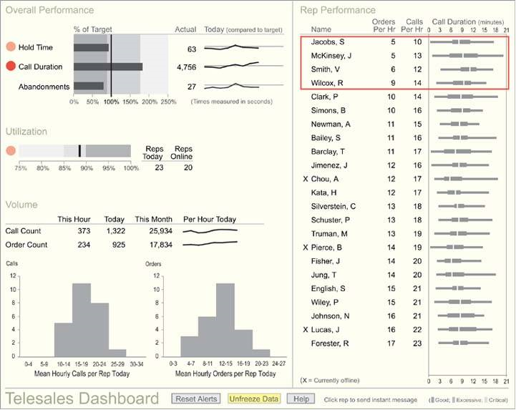
know your audience
Notes:
Operational dashboard: real time, some KPIs, not a lof of numbers, clear charts, indicators to draw attention

Slide 15
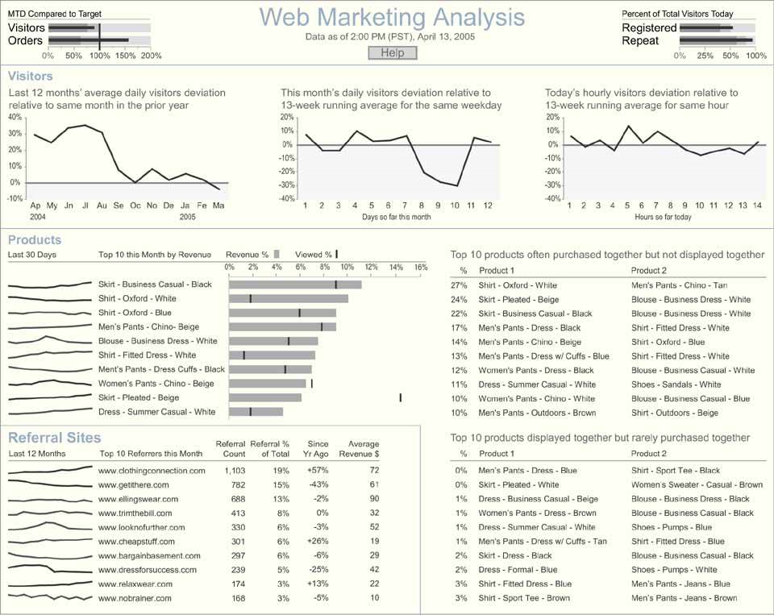
know your audience
Notes:
Analytic dashboard: numbes and charts. Possibility for drill down/up.

Slide 16
#2 Choose correct visualization type
Notes:
It’s important to use the correct medium to visualize your data. Choosing an incorrect type can result in people not using your visualization, or worse, draw the wrong conclusions.

Slide 17
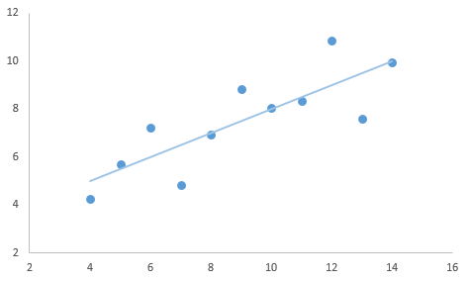
table or chart?
x | y
10 | 8,04
8 | 6,95
13 | 7,58
9 | 8,81
11 | 8,33
14 | 9,96
6 | 7,24
4 | 4,26
12 | 10,84
7 | 4,82
5 | 5,68
Notes:
Which is better? Example of growth curve vs engineer who needs exact data.

Slide 18
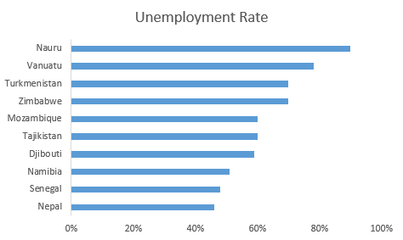
comparing categories
Notes:
Bar chart. Typically sorted on size.

Slide 19
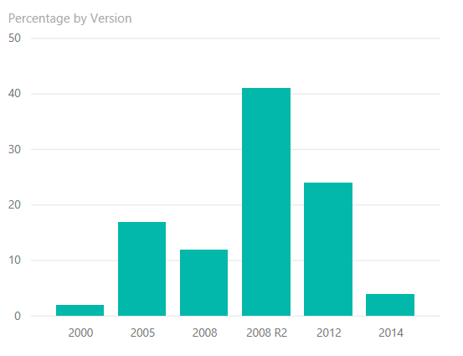
comparing categories
Notes:
Column chart. Typically sorted on size. Added bonus: chronological look ‘n feel

Slide 20
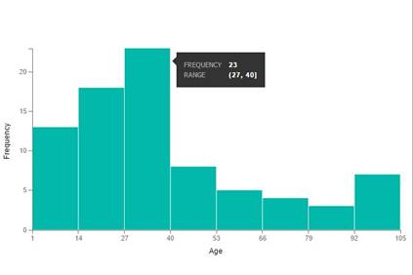
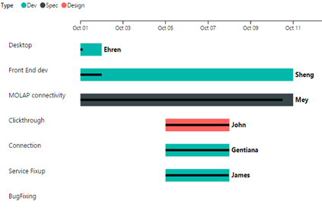
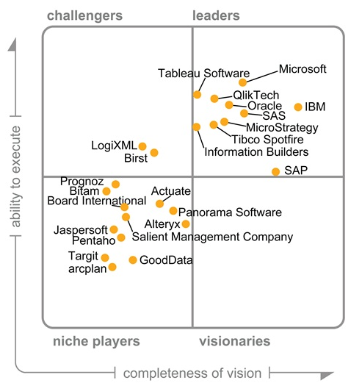
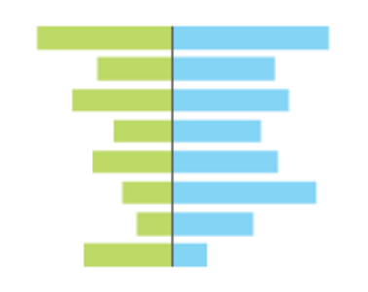
comparing categories
Notes:
Histogram, gantt chart, tornado and dot plot.

Slide 21
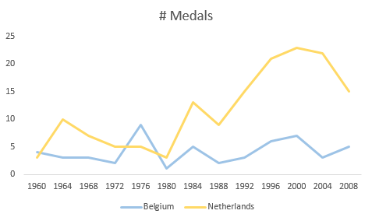
changes over time
Notes:
The line chart is obviously the best example.

Slide 22
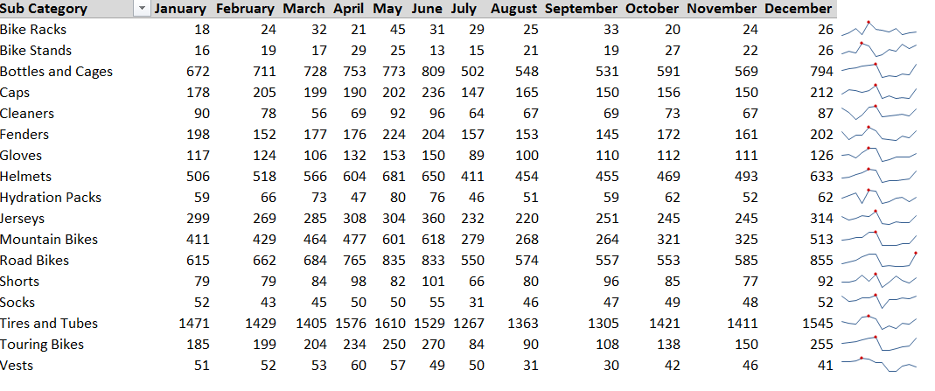
changes over time
Notes:
Sparklines are a very good chart type for condensed information.

Slide 23
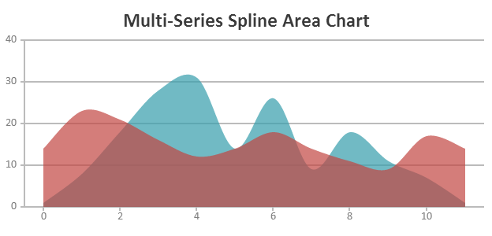
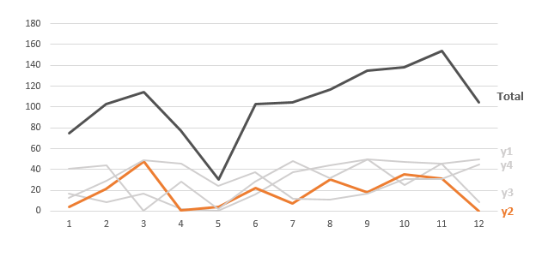
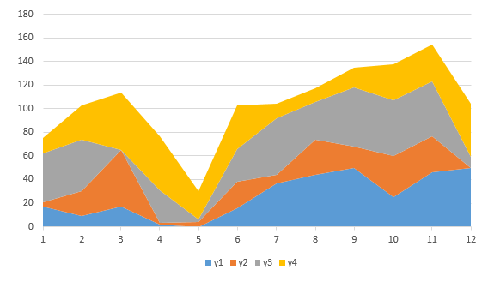
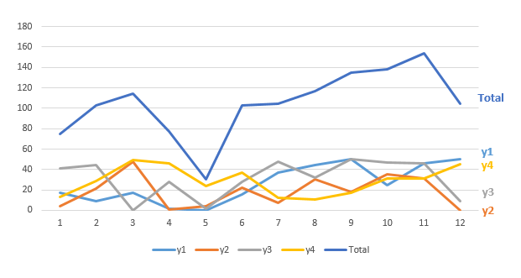
changes over time
Notes:
Area chart (talk about disadvantages)

Slide 24
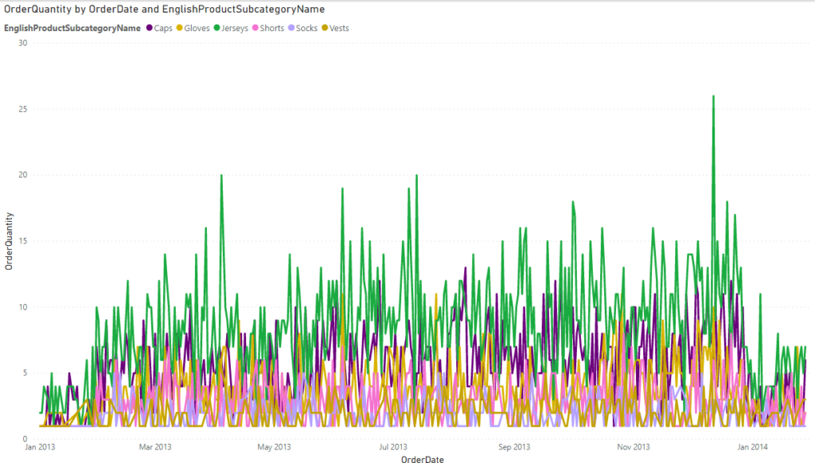
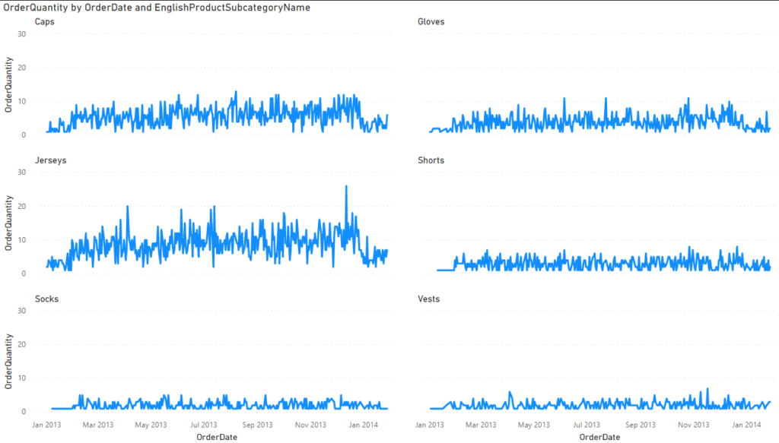
small multiples

Slide 25
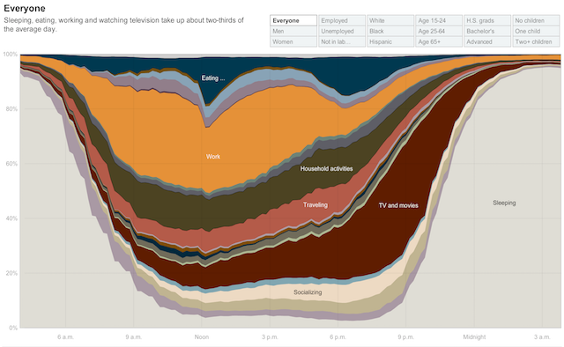
changes over time
Notes:
Stacke area charts have less disadvantages.

Slide 26
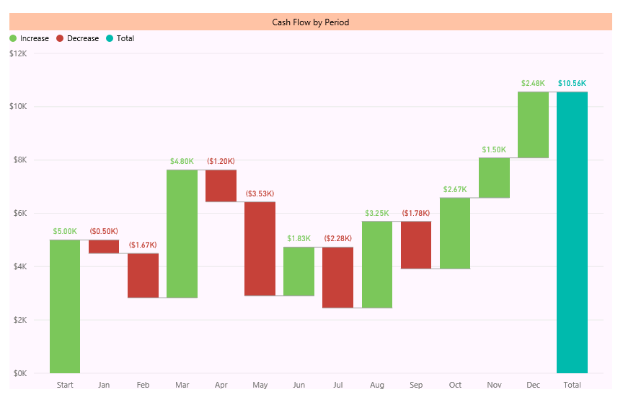
changes over time
Notes:
Waterfall chart

Slide 27
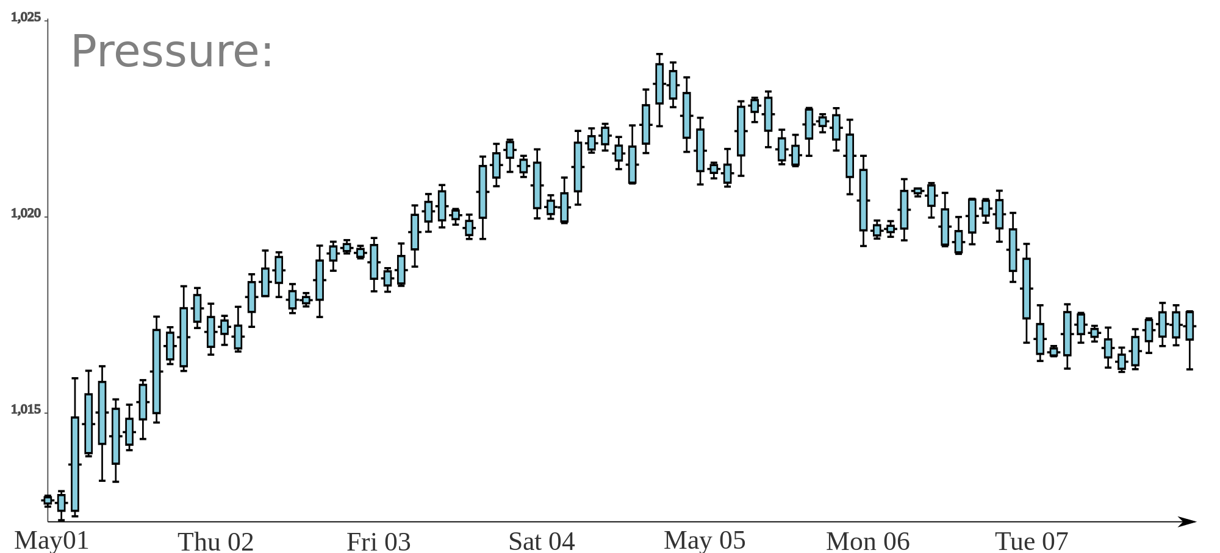
changes over time
Notes:
Candlestick chart?

Slide 28
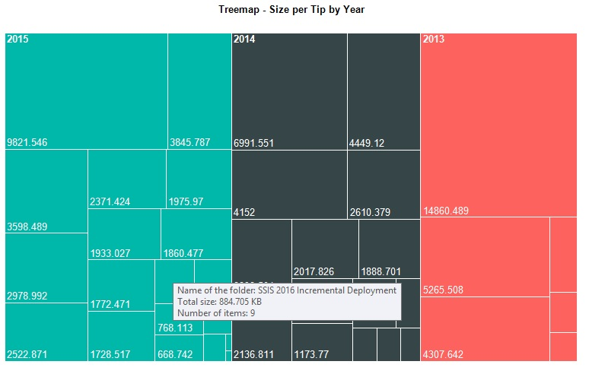
hierarchy
Notes:
Tree map (example of directory/file size on the hard drive)

Slide 29
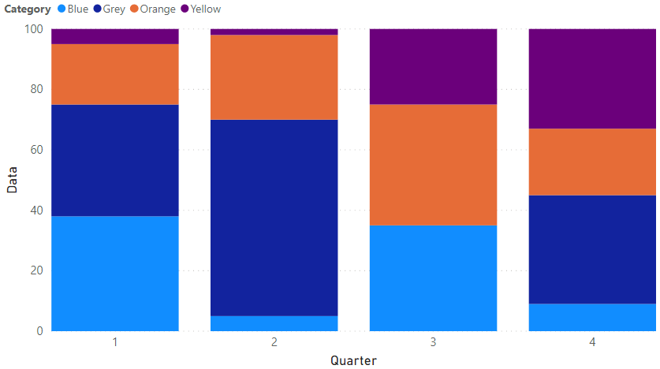
part of a whole

Slide 30
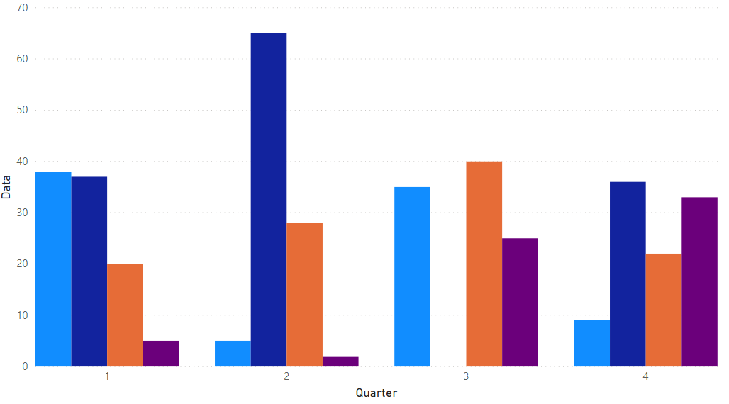
part of a whole
Notes:
Stacked bar/column charts. Also useful to track changes over time.

Slide 31
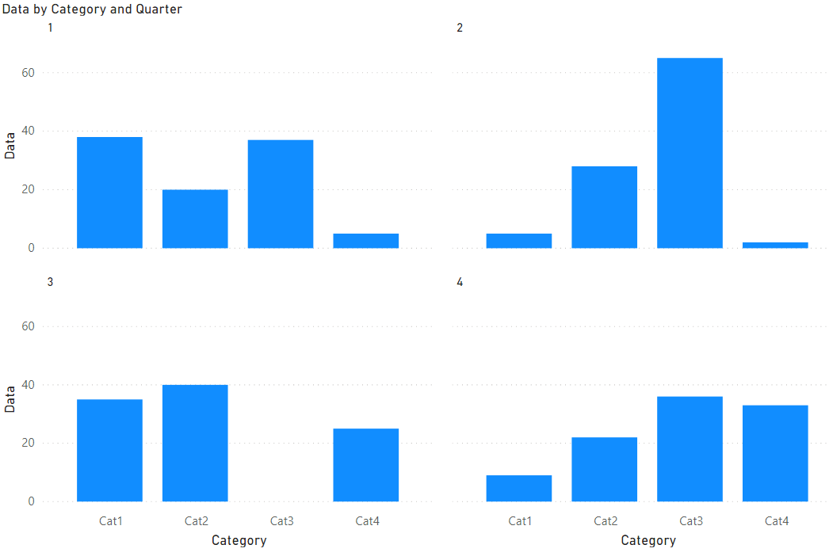
part of a whole

Slide 32
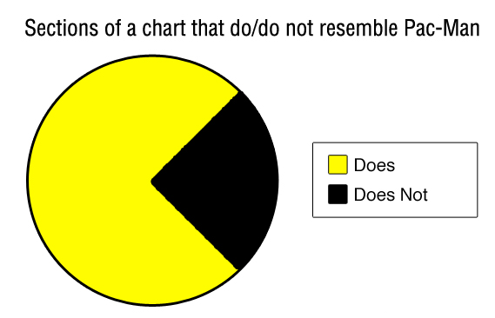
part of a whole
Notes:
The pie chart. (ominous music)

Slide 33
Intermezzo – Let’s talk about pie charts
Notes:
Let’s talk about pie charts.

Slide 34
pie charts
Only useful when the sum of the slices is 100%
Never have negative data
Not over 2-3 slices
Don’t show multiple pie charts to track changes

Slide 35
areas and angles
Notes:
28,27cm² vs 113,1cm²

Slide 36
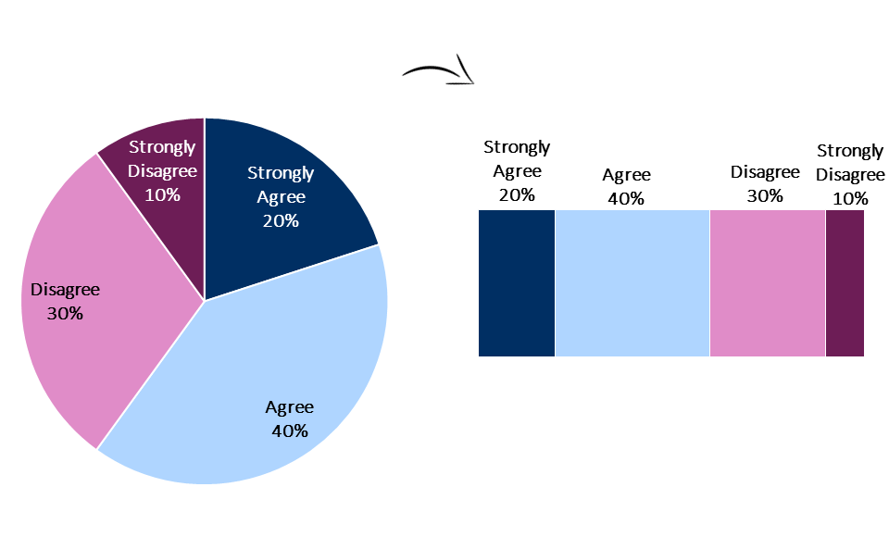
ordinal or sequential data
Source: When Pie Charts are Okay (Seriously)

Slide 37
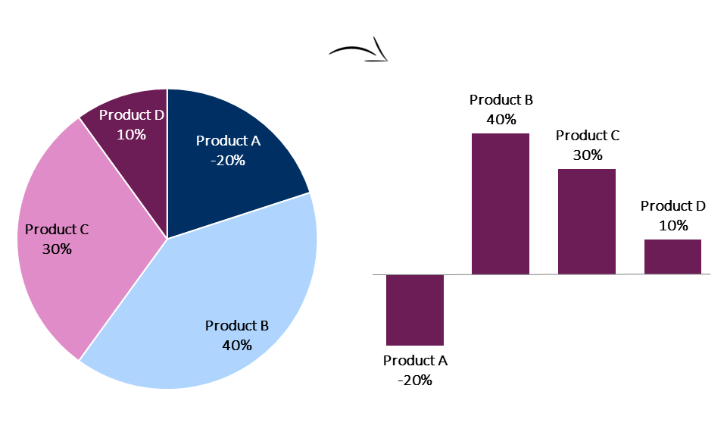
negative numbers
Source: When Pie Charts are Okay (Seriously)

Slide 38
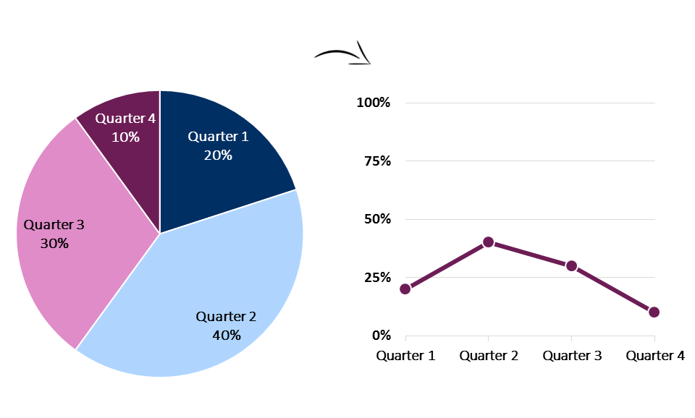
patterns over time
Source: When Pie Charts are Okay (Seriously)

Slide 39
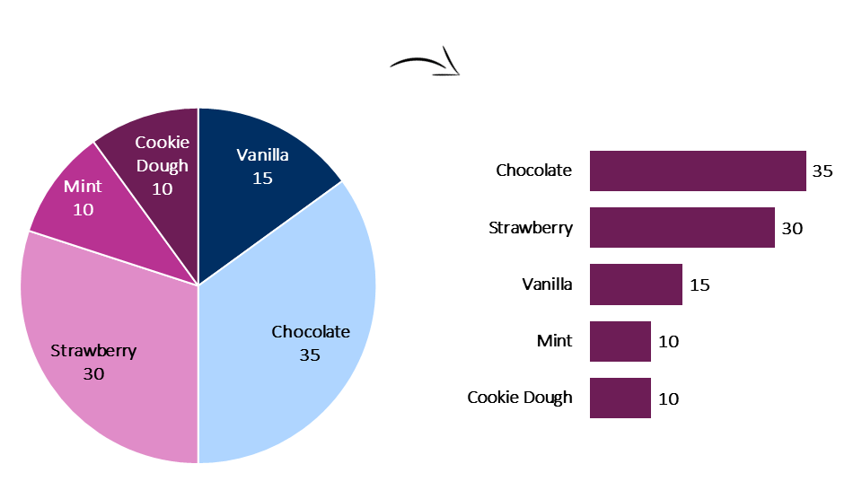
more than 2 or 3 categories
Source: When Pie Charts are Okay (Seriously)

Slide 40
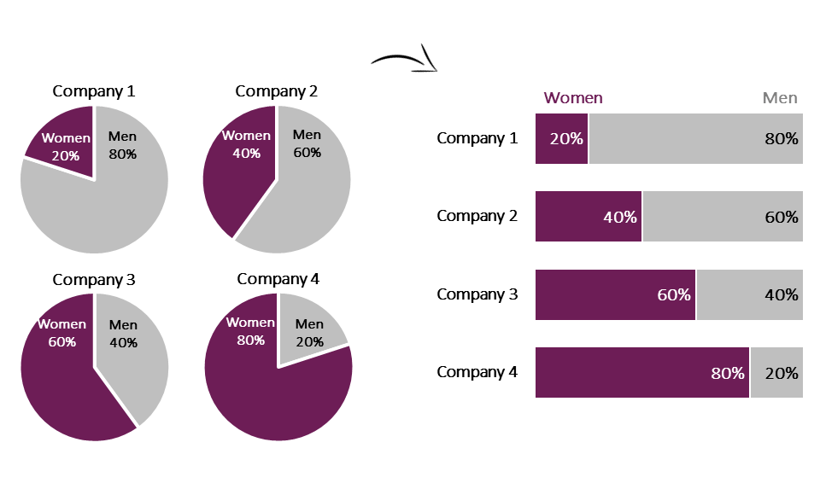
more than one chart
Source: When Pie Charts are Okay (Seriously)

Slide 41
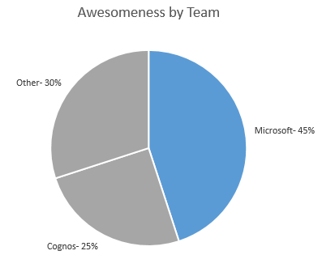
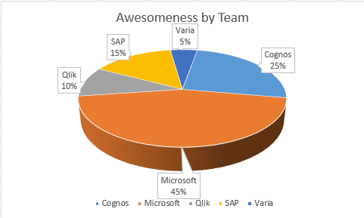
if you really need a pie chart
Sort the slices by size
Start at 12 o’clock
Never go over 3 slices
Label properly

Slide 42
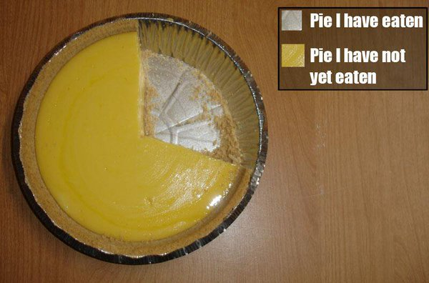
Conclusion – Save the pie for dessert
Notes:
Let’s save the pies for desssert.

Slide 43
Intermezzo – Let’s continue
Notes:
Let’s talk continue with the other chart types

Slide 44
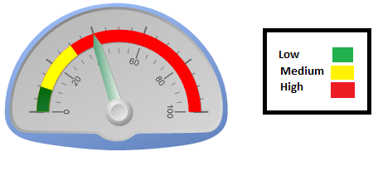
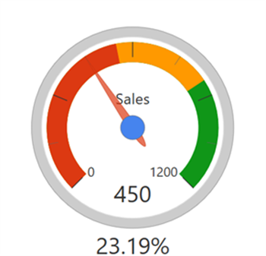
KPI
Please don’t

Slide 45
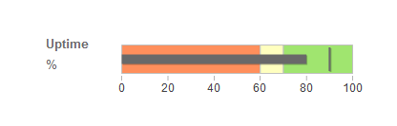
KPI
Notes:
The bullet graph is the only decent chart type for elegantly plotting actuals vs targets.

Slide 46
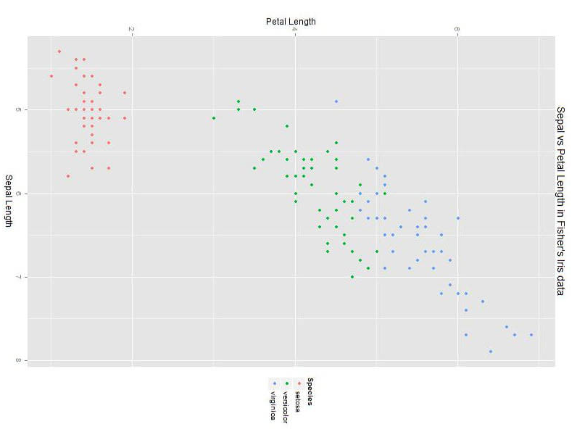
connections & relationships
Notes:
Scatter plot

Slide 47
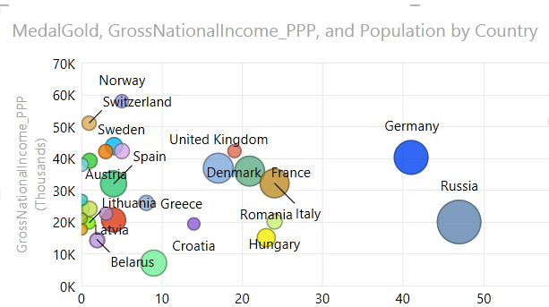
connections & relationships
Notes:
Bubble plot

Slide 48
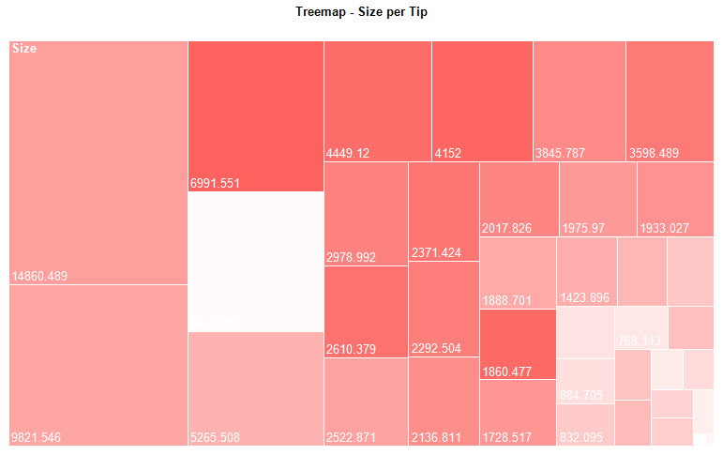
connections & relationships
Notes:
Heat map (relationship between size and number of items in a folder).

Slide 49
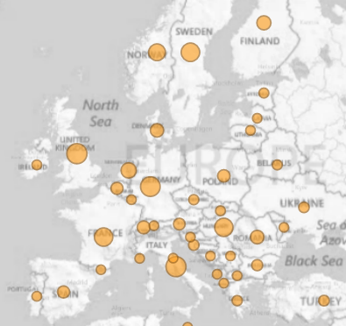
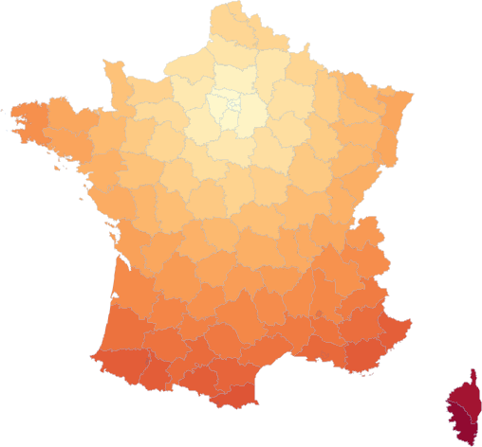
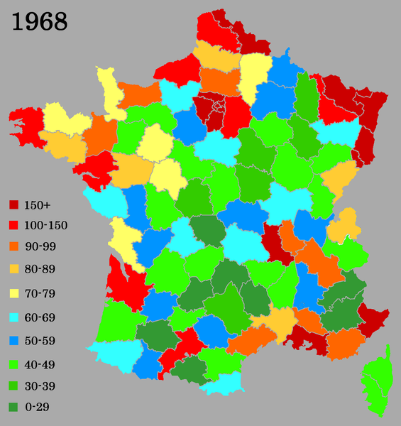
geographical data
Notes:
Bubble plot or filled areas.

Slide 50

you don’t always need a map
Notes:
Something the location component just isn’t that important.

Slide 51

correlation is not always causation

Slide 52

correlation is not always causation

Slide 53
#3 Reduce data-ink ratio
Notes:
Only display pixels if they are important to tell the story of the data. Discard everything else.

Slide 54
Don’t use 3D
Ever.
Notes:
Never use 3D.

Slide 55
Seriously.
Don’t.
Notes:
Like never.

Slide 56




why not?
Notes:
Which slice is bigger? The grey, the blue or the orange one? (hint: they are all the same size = 20%)
What is the value of the second bar?

Slide 57

why not?
Notes:
If you’re not careful, 3D viz can hide some of the data.

Slide 58
data-ink ratio
1 Remove non-data pixels
no 3D, gradients, backgrounds or shadows
remove grid lines, decoration, borders, fill colors (unless absolutely necessary)
2 Remove non-necessary data pixels
display only what’s necessary to tell the story
3 Highlight most important pixels

Slide 59



remove non-data pixels

Slide 60


remove non-necessary data pixels
Notes:
If you don’t need all subcategories, remove them.

Slide 61

highlight most important pixels

Slide 62
highlight most important pixels

Slide 63

example – pie chart

Slide 64


example – bar chart
Koos van Strien - Creating non-ugly SSRS reports #1

Slide 65


example – dashboard
Koos van Strien - Creating non-ugly SSRS reports #5
Notes:
Talk a bit about dashboard design best practices.

Slide 66
#4 Use visual perception
Notes:
There’s a whole science about visual perception: the ways we perceive visual objects in our brain. This can help you with the design of reports and dashboards.

Slide 67
visual perception
1389245678971321654987132189456423151560321654256487450005121736545023454351021545454987840579218600479333470
1389245678971321654987132189456423151560321654256487450005121736545023454351021545454987840579218600479333470
Notes:
In visual perception, we have pre-attentive processing which is very fast. A bit like a cache before RAM.

Slide 68

visual perception vs quantative
Notes:
There are several preattentive attributes of visual perception. Some can be used to encode quantative information.

Slide 69


principle of proximity
Notes:
The gestalt principles (gestalt = pattern) are patterns of visual perception. These patterns can be used to group data together in a dashboard, separate them or make data stand out.

Slide 70

principle of similarity

Slide 71

principle of enclosure

Slide 72


principle of closure and continuity
continuity
closure
Notes:
Continuity also works as indentation in a table.

Slide 73



don’t forget the 10%

Slide 74
#5 Tables need some design as well
Notes:
There’s a whole science about visual perception: the ways we perceive visual objects in our brain. This can help you with the design of reports and dashboards.

Slide 75
some tips
White space is your friend
Numbers are aligned right, text is aligned left
Align headers with column values
Use the same precision everywhere in a column
Don’t overuse colors and gridlines
Notes:
Use white space instead of lines

Slide 76

example – table

Slide 77


example – table

Slide 78

example – table
Koos van Strien - Creating non-ugly SSRS reports #2

Slide 79
Extra: Lying with charts
Notes:
There’s a whole science about visual perception: the ways we perceive visual objects in our brain. This can help you with the design of reports and dashboards.

Slide 80


the color coded map
Source: Harvard Business Review

Slide 81


truncated Y-axis
Source: Harvard Business Review

Slide 82


truncated Y-axis
Source: How to Lie with Data Visualization

Slide 83


cumulative growth
Source: How to Lie with Data Visualization

Slide 84


toying with the scale
Notes:
Either change the length of the scale to change the slope.
Or change the scale itself: normal vs logarithmic

Slide 85
some tips to avoid confusion
Use a clear title
Clearly name and label axis
Don’t truncate the axis
Use the correct visualization
Notes:
Use white space instead of lines

Slide 86


resources

